Slide 1
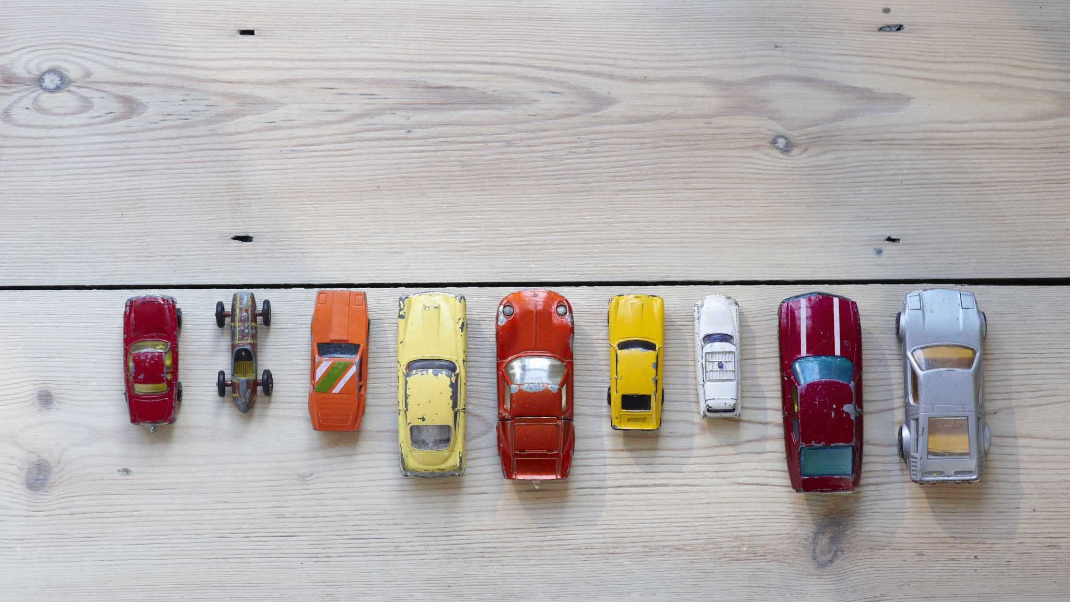
Evaluation and Analysis of Car Accidents Using Scientific Data Visualization
By Group
Likitha Baddam - 11646434
Rajagopal Naidu Kodavati - 11596822
Jaya Naga Satya Pavan Ganesh Kotipalli - 11594936
Anil Kumar Reddy Vanteru - 11724866

Slide 2
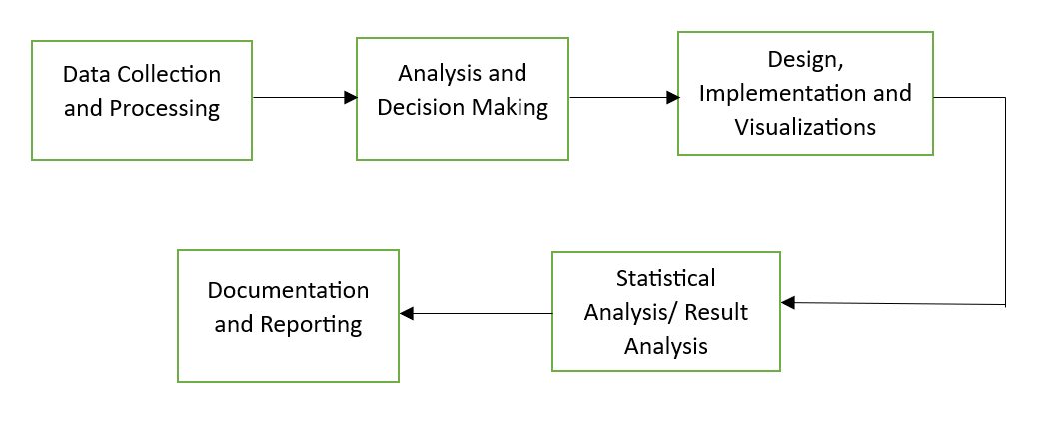
INTRODUCTION
DOMAIN: Our project relies intersecting public transportation, Road Safety, and Public & Economic Facilities which is the Social Science domain.
WORKFLOW

Slide 3
DATA ABSTRACTION
Dataset: We have taken 2 datasets
Car Accident Dataset
Insurance Complaints Dataset
The dataset type is a csv file whereas the records(Attributes) which highlight our analysis are as below
Number_of_Vehicles
Day_of_Week
Number_of_Casualties
Road_Surface_Conditions
Complaint number
Received date
Complaint filed by
Complaint filed against
https://www.kaggle.com/datasets/nextmillionaire/car-accident-dataset
https://catalog.data.gov/dataset/insurance-complaints-all-data

Slide 4
DATA ABSTRACTION cont.

Slide 5
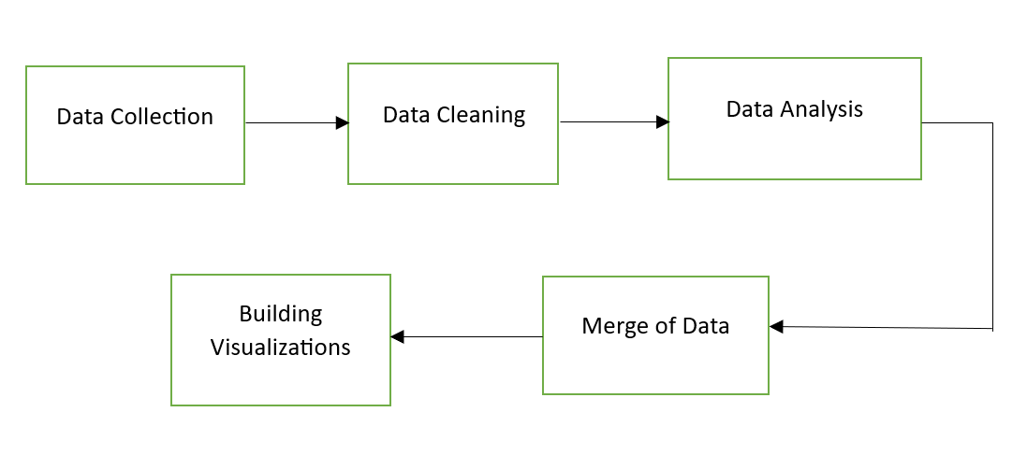
DATA ABSTRACTION cont.
Data Workflow

Slide 6
DATA ABSTRACTION cont.
Data Workflow
Data Collection – This process is definitely a challenging as we need to collect suitable data according to our output visualizations
Data Cleaning – In this we removed null values and for some attributes where there are fewer missing values, we have replaced them with mean of the column.
Data Analysis – This step includes the analyzing part between two taken datasets. To analyze the similarities leading us to draw the ideas and visualizations.
Merge of Data – This step goes with merging two datasets by verifying the rows and columns related.
Building Visualizations – The above steps definitely helped us to build visualizations diving into both datasets and the required statistical information.

Slide 7
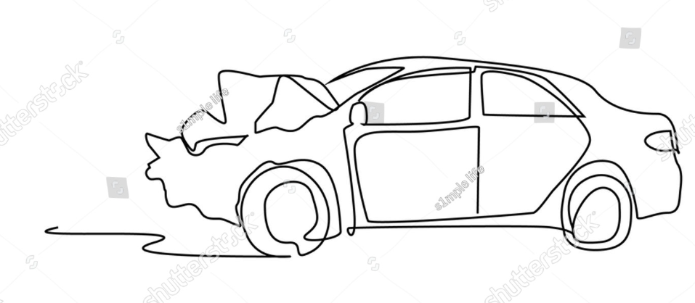
TASK ABSTRACTION
Here are the tasks we performed in this project. Let's dive directly into Targets and their plan of action.
Target:
To analyze the causalities occurred in a day basis, their patterns, nature influence, trends and structure of the car accidents.
To analyze the insurance claiming patterns and trends.
To develop a visualization to present these insights on how well we can draw and analyse the patterns.
Actions:
To reach our target we have first collected the required datasets.
Cleansed the dataset on car accidents and insurance data.
Fixed the null values and outliers.
Merged dataset to analyze and identify the correlation and patterns
We used visualization tools like D3.js, Tableau and Power BI.
Next analyzed all the trends and patterns according to the visualizations gained.

Slide 8
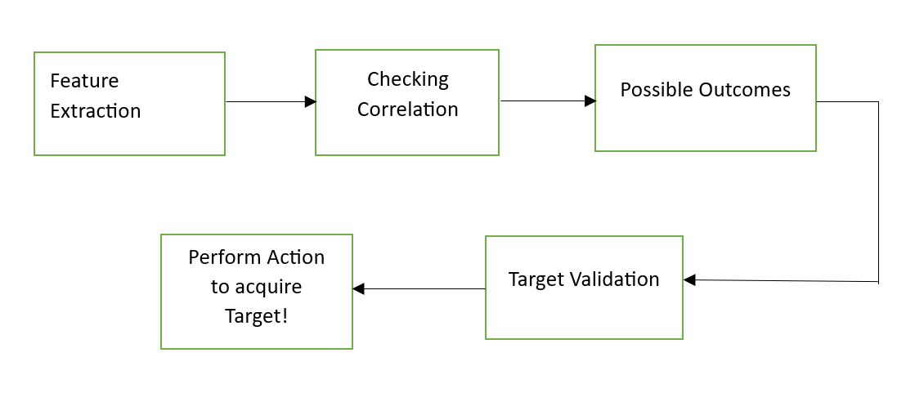
TASK ABSTRACTION
Workflow

Slide 9
TASK ABSTRACTION
Workflow
Feature Extraction: Transforming raw or original data into numerical attributes to gain insights to our target.
Correlation Check: To build correlation or relatability between two columns or attributes. E.g. Accident vs. Insurance.
Possible Outcomes: Brainstorming different ways through the achieved attribute correlations.
Target Validation: Outlining the targets to ensure possible strategies.
Perform Action to Acquire Target: We perform the task and target actions using various tools to acquire the target.

Slide 10


IMPLEMENTATION USING TOOLS
We used various Visualization tools. The prime ones are Tableau, Microsoft Power BI, Vizhub for data web development.
In Vizhub we used d3.js library for skeleton, styling and functionality of the visualization.
We designed the interactive dashboards by using these tools.
These dashboards are put into action to get the information about each data point upon selected.

Slide 11
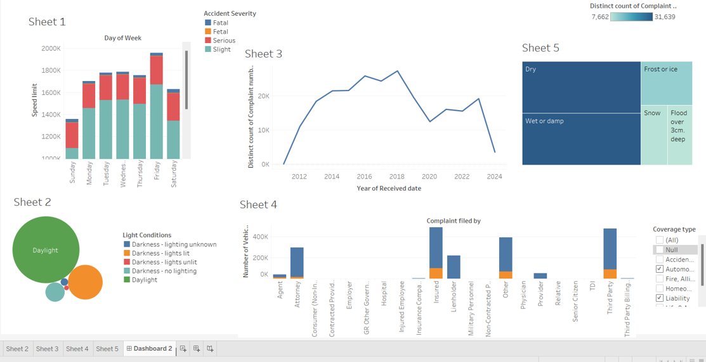
RESULTS FOR ANALYSIS Below is the dashboard showing all the relations that obtained during analysis

Slide 12
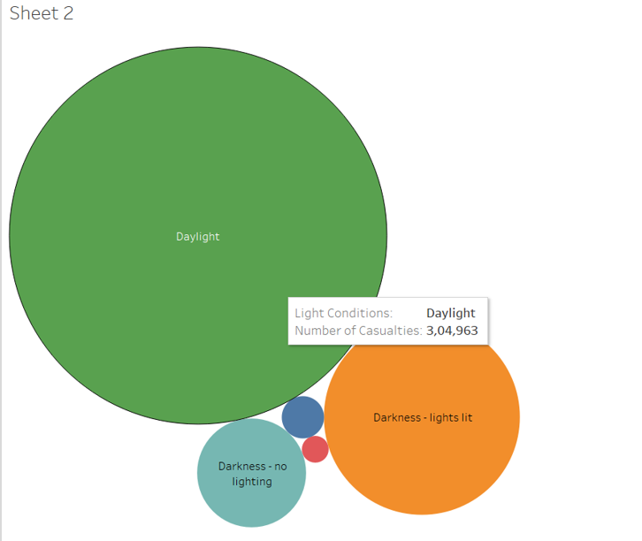
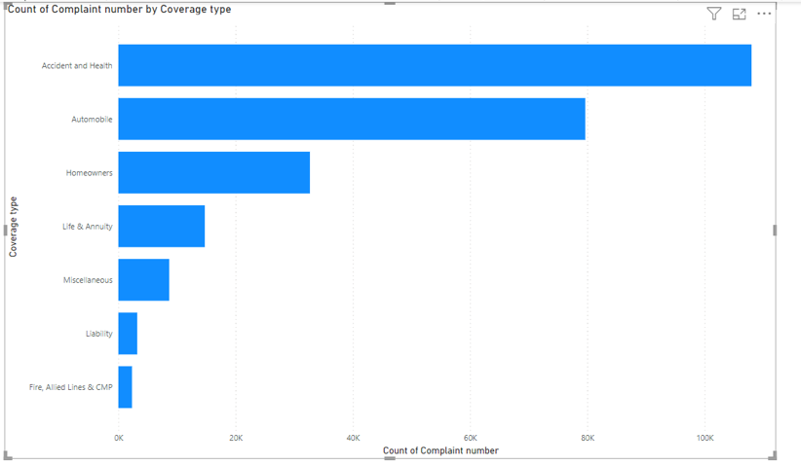
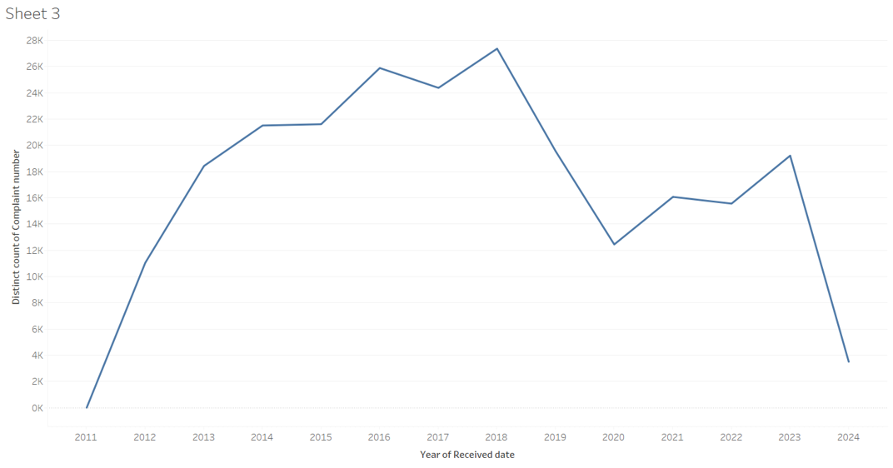
The major outcome of the project is the development of interactive dashboards that can give the information at any instance.
In each dataset we taken the keys and established a relation between the keys. This significantly helps us to statistically analyze the major factors which causes this problem or accidents.
The insurance reports shows an outcome that the insurances claims are more on the aspect of accident and health, which is highest compared to all categories of claim.

Slide 13
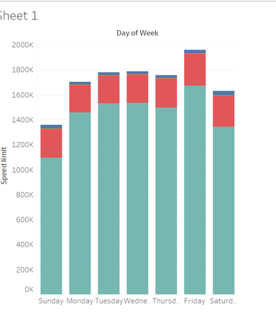
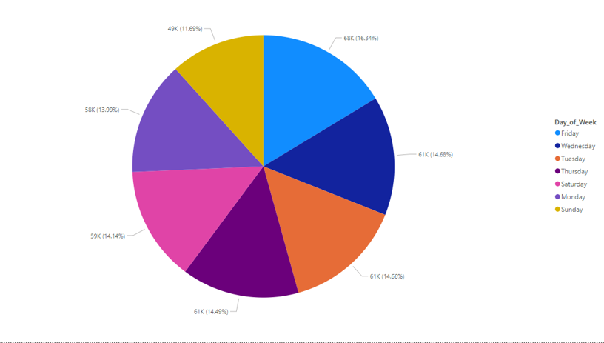
The count of accidents is more on the weekends than any other day, as compared to other days of a week, especially on Fridays. In the day light the causalities are very high compared to other times of a day which is 16.34%.

Slide 14
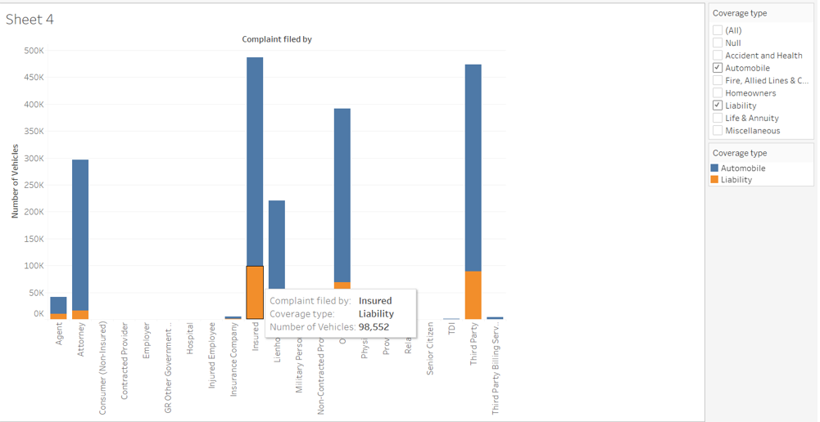
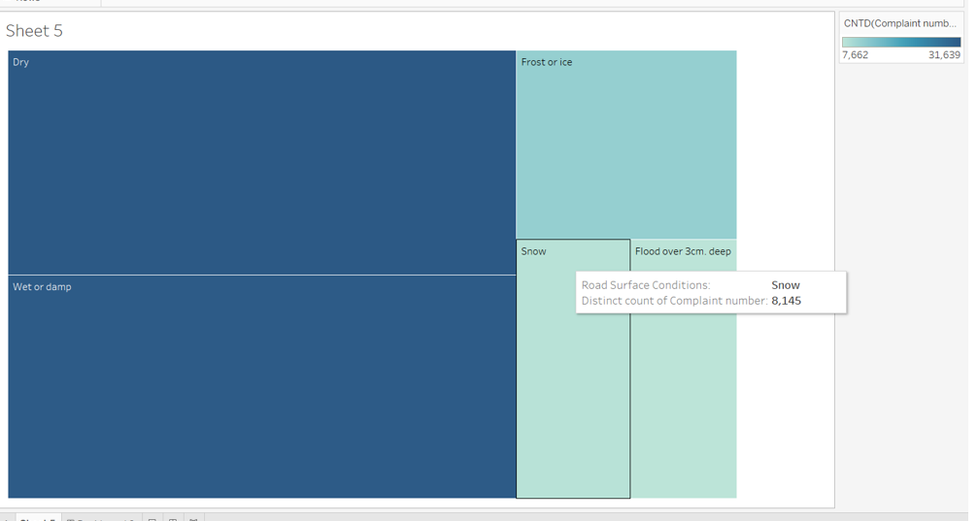
Irrespective of the road condition most low number of accidents happening on snow day.
Nearly one million vehicles accounted for liability insurances.
Most of the complaints are raised by the insured category.

Slide 15
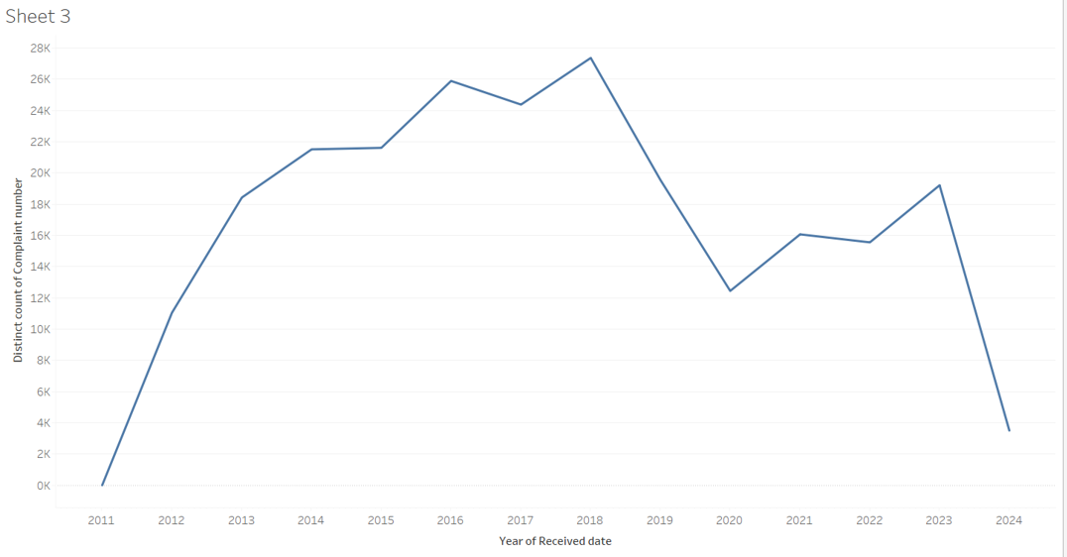
The line graph show the count of complaints happening in certain years.
On the year 2018 the accidents are very high which is nearly less than 28 thousands

Slide 16
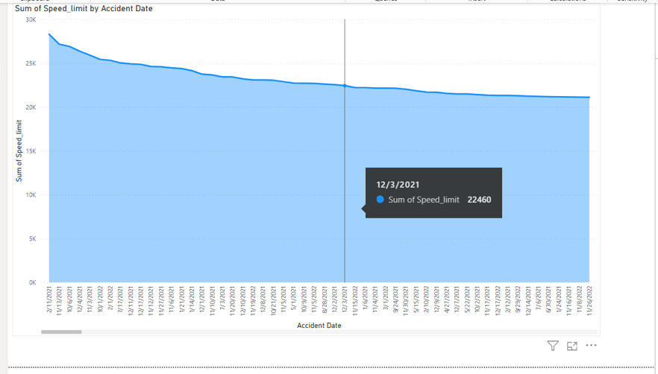
The sum of speed limits decreases with date. By keeping the cursor at any instance we can get the value of sum of speed limit and date

Slide 17
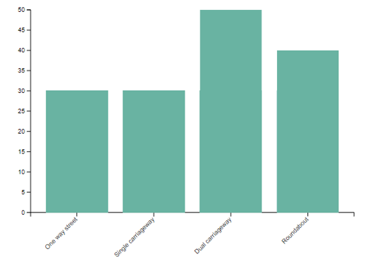
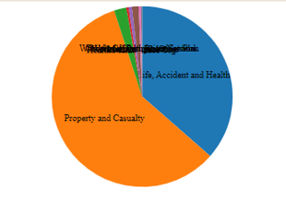
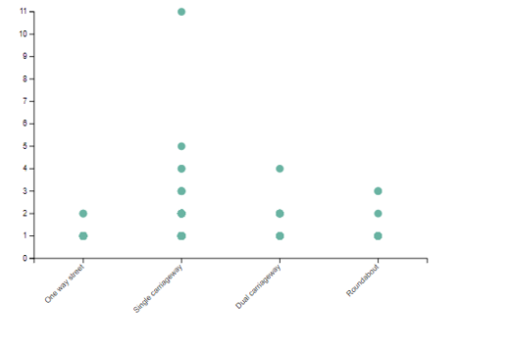
The bar graph shows the road type reflecting the count of accidents,
Most accidents are occurring on Dual Carriage away roads which is nearly 50 thousand, followed by roundabout.
Most of the insurance company complaints are related to accidents and Health which is the second largest issue on insurance complaints.

Slide 18

WORK MANAGEMENT
Implementation Status Report
Responsibility of Task: Below is the person responsible for their individual tasks.
Likitha – Responsible for Tableau visualizations, Correlation of Data, Statistical analysis of visualizations in Tableau.
Rajagopal - Responsible for Power Bi and D3.js visualizations, Statistical analysis of visualizations in Power Bi and D3.js visualizations.
Jaya Naga Pavan – Responsible for Data collection, Feature extraction and Target Validations.
Anil – Responsible for Possible Outcomes, Statistical Analysis and Documentation.

Slide 19

REFERENCES
https://towardsdatascience.com/easy-maps-with-tableau-4f56a8dcff0d
https://ivypanda.com/essays/road-accidents-storytelling-through-tableau-visualizations/
https://www.academia.edu/61092412/Road_Traffic_Accident_Data_Analysis_and_Its_Visualization?f_ri=220864

